Slide 1
Lecture 1 Welcome to the World of Economics
Dr. Dowlah
Fall 2016
CDowlah@qcc.cuny.edu

Slide 2
Welcome to the World of Economics
We spend a great deal of our time every day thinking about economic issues, such as prices, goods, and choices of using time, money and energy. All such thinking and actions are economic in nature. They are parts of the subject called Economics.
Economics is a subject that teaches us how to minimize costs and how to maximize benefits, that is, how to use resources of a nation most efficiently.
This course will reinforce your economic thinking by equipping you with some fundamental tools and techniques of Economics so that your economic knowledge becomes more scientific and more dependable.

Slide 3
The concepts, such as Economics, Economy, Economic Systems are not interchangeable. Each one has a distinct meaning.
The term “Economics” refers to a discipline—a field of knowledge that explains how a society/country can manage its scarce resources most efficiently.

Slide 4
Economics is specialized subject—it is based on scientific knowledge and methodology, and it uses specialized vocabulary.
The terms and concepts used in the subject have their own meanings, different from ordinary meanings.

Slide 5
THE WORLD’S LARGEST ECONOMIES, 2016
Ranking | Countries | GDP ($ trillions) | Share in world economy
1 | United States | 18.56 | 25
2 | China | 11.38 | 15
3 | Japan | 4.41 | 6
4 | Germany | 3.47 | 4.7
5 | United Kingdom | 2.76 | 3.7
6 | France | 2.46 | 3.3
7 | India | 2.29 | 3.1
8 | Italy | 1.85 | 2.5
9 | Brazil | 1.53 | 2.1
10 | Canada | 1.46 | 2.0
 | World | $74.00 | 100
The size of the countries is based on nominal annual income of these countries, not on their wealth or assets.
Source: IMF World Economic Outlook, 2016.

Slide 6
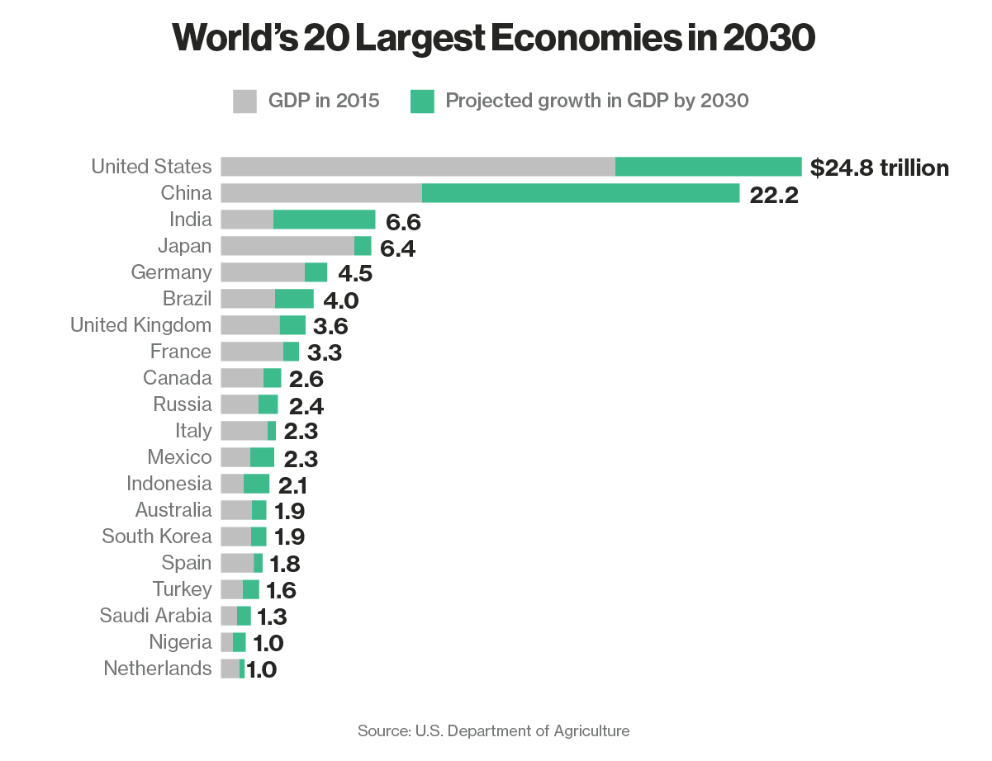

Slide 7
Richest Nations in the world, 2016
Top Ten Per Capita Income in the world, 2013 (Per capita income = GDP divided by Population)
1. Qatar $140,649
2. Luxemburg $97,662
3. Singapore $82,763
4. Kuwait $82,763
5. Brunei $71,185
6. United Arab Emirates $67,674
7. Norway $64,856
8. Switzerland $57,235
United States $54,630
Saudi Arabia $51,924
Source: World Atlas. Based on data from the World Bank and the International Monetary Fund. GDP based on purchasing power parity per capita that takes into account the relative cost of living and the inflation rates of the countries to compare living standards among the different nations.

Slide 8
COUNTRIES WITH THE LARGEST POPULATION, 2016
# | Country | Population
1 | China | 1.38 Billion
2 | India | 1.33 Billion
3 | United States | 324.11 million
4 | Indonesia | 260.58m
5 | Brazil | 209.57m
6 | Pakistan | 192.83 m
7 | Nigeria | 186.99 m
8 | Bangladesh | 162.91 m
9 | Russia | 143.44m
10 | Mexico | 128.63 m
World Population |  | 7.34 Billion
Chinese population is 4.3 times larger than the USA. With the level of US productivity, Chinese GDP should be ----?
Source: Based on data by United Nations, Department of Economic and Social Affairs,

Slide 9
Geographically, the top 10 largest countries in the world
(in square miles)
1. Russia: (6.6m)
2. Canada: (3.8 m)
3. United States (3.7m)
4. China (3.7m)
5. Brazil (3.3 m)
6. Australia: (2.9m)
7. India (1.3m)
8. Argentina: (1.1m)
9. Kazakhstan: (1.1m)
10. Algeria: (0.92m)

Slide 10
The Concepts of Efficiency and Productivity
Efficiency means the fullest utilization of existing resources so that no resources are left unutilized, underutilized or unemployed.
Economic Efficiency means when nobody can be made better-off, without making somebody worse-off.
Productivity refers to value added per worker per hour.

Slide 11
Economic Freedom
Economic freedom is the ability to engage in voluntary trade without interference or restrictions by government or outside parties
In an economically free society, individuals are free to work, produce, consume, and invest in any way they please
In general, the greater a nation’s economic freedom, the higher its Standard of Living

Slide 12
Most Economically Free Countries in the World, 2016
Rank | Countries | Score
1 | Hong Kong | 88.6
2 | Singapore | 87.8
3 | New Zealand | 82.0
4 | Switzerland | 81.0
5 | Australia | 80.3
6 | Canada | 78.0
7 | Chile | 77.7
8 | Ireland | 77.3
9 | Estonia | 77.2
10 | United Kingdom | 76.4
11 | United States | 75.4
Based on Economic Freedom Index, Heritage Foundation.

Slide 13
Economic Rationality
Rational Self-Interest—Most economic analysis is based on the assumption that human beings are rational.
We assume that given the information and resources at their disposal, human beings make decisions/choices that give them greatest amount of satisfaction.

Slide 14
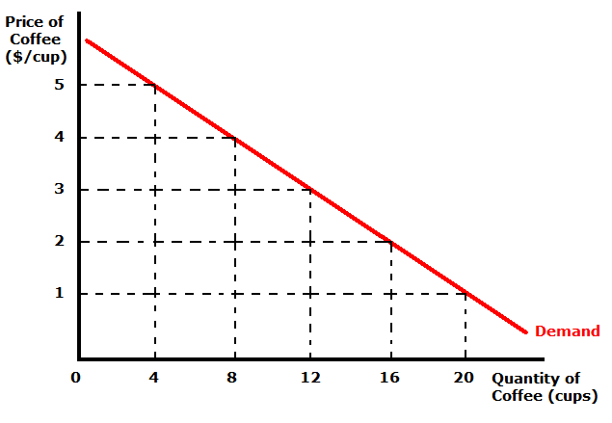
Ceteris Paribus
All economic theories/models/laws/assumptions work under the conditions of what is called Ceteris Paribus, which means every thing else remains constant.
Will you buy the same amount of coffee each week if your income falls?

Slide 15
Approaches to economic analysis
Positive analysis or Positive Economics—analysis of what is. It is objective analysis of Economic issues based on scientific methods.
Normative analysis or Normative Economics—what ought to be. It is a subjective interpretation of economic issues, but based on objective findings.

Slide 16
Branches of Economics
Macroeconomics (macro means large). Macroeconomics deals with large, aggregate economic issues, such as: unemployment, inflation, economic growth, business cycle, international trade, and fiscal and monetary policies.
Microeconomics (micro means small). Microeconomics deals with smaller (micro) issues, such as consumer behavior, production behavior, and government-business relations.

Slide 17
Factors of Production
A. Land—Gifts of Nature.
Labor—Human Contribution to Production Process.
C. Capital—Machinery, equipment, plants.
D. Entrepreneurs—those people who put together the factors of production and take risk. .

